Slide 1
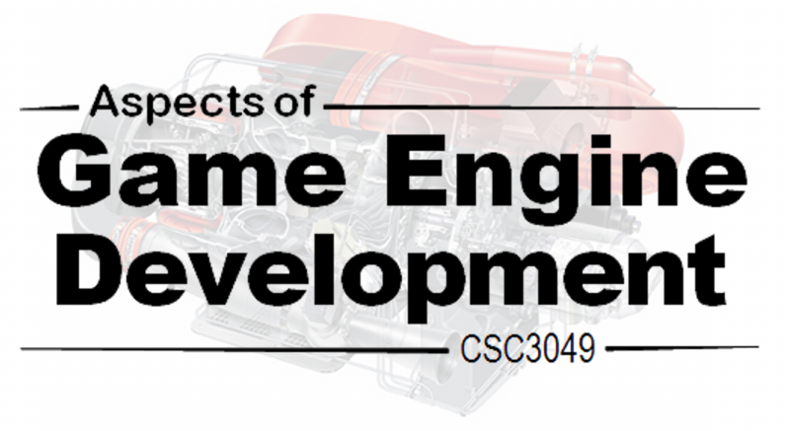
2.3. Bounding Volumes
Bounding volumes of use for collision detection

Slide 2
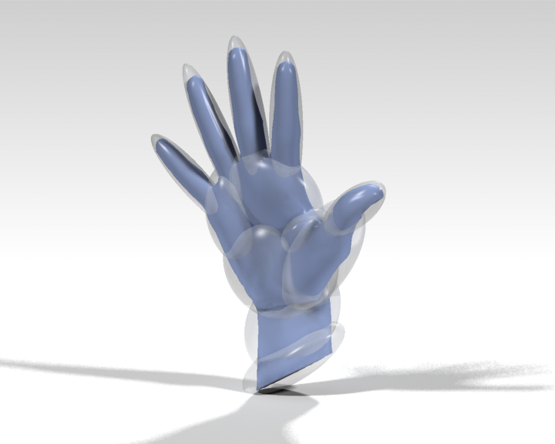
Bounding Volumes
Simple implicit/explicit bounding volumes for complex geometry

Slide 3
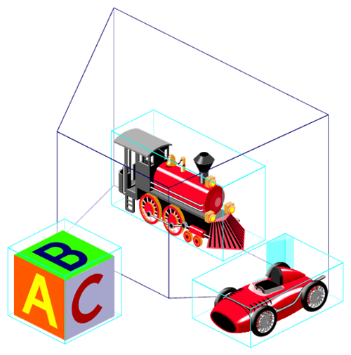
Introduction to Bounding Volumes
A bounding volume is simply a volume that bounds (i.e. encapsulates) one, or more, objects. Bounded objects can have arbitrarily complex geometry.
A geometrically simple bounding volume entails that collision tests can be initially against the bound (permitting fast rejection), followed by a more complex and accurate collision test if needed.
In some applications, the bounding volume intersection suffices to determine intersection between the bounded objects.

Slide 4
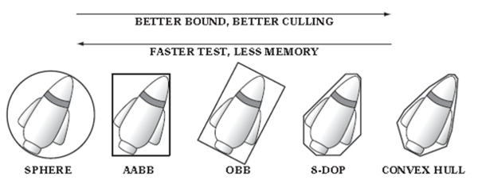
Ideal characteristics of a bounding volume
Ideally a bounding volume should:
Provide an inexpensive test for intersection
Fit tightly around the bounded object(s)
Be inexpensive to compute
Be easy transformed (e.g. rotated)
Require little memory for storage
Often, the above characteristics are mutually opposed to one another.

Slide 5
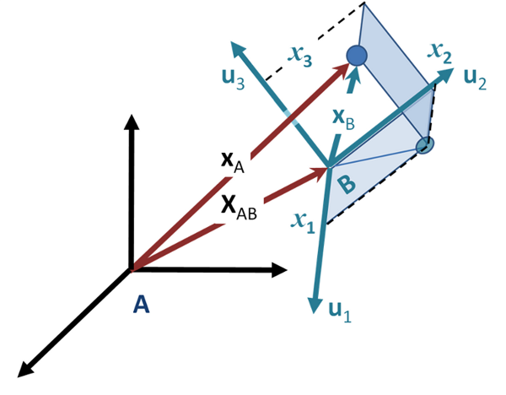
Bounding volume local coordinate systems
Bounding volumes are typically specified in object (or model) space. In order to test for collision, the bounding volumes need to be expressed within a common coordinate system.
This could be done in world space, but it is typically quicker to convert one volume into the local space of the other bound (only one transfer needed – faster and helps preserve bound accuracy).
Some bounds, e.g. spheres, easily convert between coordinate systems (a sphere is invariant under rotation) and are termed non-aligned. Other bounding volumes (e.g. AABB) have restrictions imposed on orientation and need to be realigned following any object rotation.

Slide 6
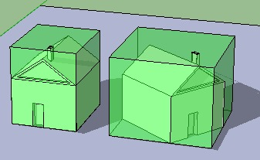
Axis-aligned bounding volumes (AABB)
An axis-aligned bounding box (AABB) is a rectangular box whose face normals are parallel to the axes of the coordinate system.
An AABB can be compactly represented as a centre point and associated half-width axis-extents distances.
Two AABB bounds overlap if:
bool Overlap( AABB one, AABB two )
{
if( Abs(one.Center.X – two.Center.X)
>(one.Extent.X – two.Extent.X)
|| Abs(one.Center.Y – two.Center.Y)
>(one.Extent.Y – two.Extent.Y)
|| Abs(one.Center.Z – two.Center.Z)
>(one.Extent.Z– two.Extent.Z)
return false else return true;
}
struct AABB {
Vector3 Centre
Vector3 Extent
}
Where region R = { (x,y,z) |
|Centre.x – x| <= Extent.x,
|Centre.y – y| <= Extent.y,
|Centre.z – z| <= Extent.z }

Slide 7
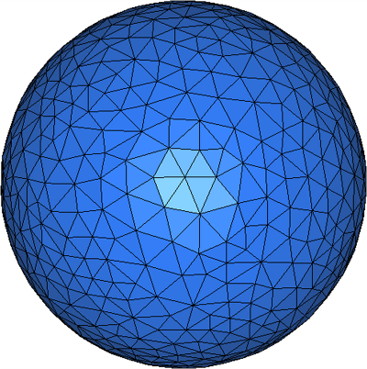
Sphere bounding volume
As with AABBs, spheres benefit from an inexpensive intersection test and are rotationally invariant (i.e. easy to transform from one coordinate system to another). They offer the most memory compact bound representation.
Spheres are defined in terms of a centre position and a radius. Two bounding spheres overlap if:
bool Overlap( Sphere one, Sphere two )
{
Vector3 separatingVector
= one.Centre – two.Centre;
float distance
= separatingVector.LengthSquared();
float radiusSum = one.Radius + two.Radius;
return distance < radiusSum * radiusSum;
}
struct Sphere {
Vector3 Centre
float Radius
}
Where region R = { (x,y,z) |
(x-Centre.x)^2 +
(y-Centre.y)^2 +
(z-Centre.z)^2 <= Radius^2

Slide 8
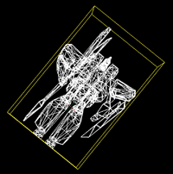
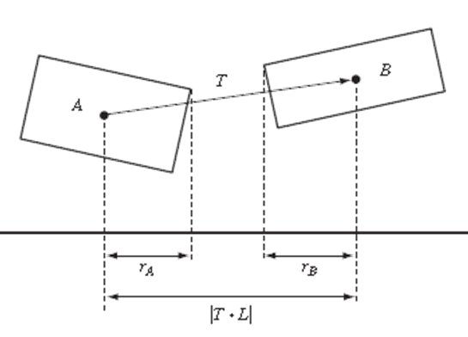
Oriented Bounding Boxes (OBBs)
An oriented bounding box (OBB) is an arbitrarily oriented rectangular bound. The most common means of representing an OBB, permitting straightforward intersection tests is as shown:
struct OBB {
Vector3 Centre
Vector3[3] Axis
Vector3 Extent
}
Where region R = { (x) | x = Centre +
(r*Axis.X + s*Axis.Y + t*Axis.Z ) },
|r|<Extent.X, |s|<Extent.Y, |t|<Extent.Z
Intersection testing is more complex than that for an AABB. A separating axis test is often used (explored later). The OBBs are not intersecting if there exists an axis on which the sum of their projected radii onto the axis is less than the distance between the projection of their centre points onto the axis:

Slide 9
Oriented Bounding Boxes (OBBs)
For OBB-OBB at most 15 axes need to be tested (three coordinates axes of each box (a_{x} , a_{y} , a_{z} , b_{x} , b_{y} , b_{z}) and nine axes perpendicular to each coordinate axis (a_{x}× b_{x} , a_{x}× b_{y} , a_{x}× b_{z} , a_{y}× b_{x} , a_{y}× b_{y} , a_{y}× b_{z} , a_{z}× b_{x} , a_{z}× b_{y} , a_{z}× b_{z} )
bool Overlap( OBB one, OBB two )
{
Matrix rotMat;
for (int i = 0; i < 3; i++)
for (int j = 0; j < 3; j++)
rotMat[i][j] = Dot(one.Axis[i], two.Axis[j]);
Vector translation = two.Centre - one.Centre;
translation = new Vector( Dot(translation, one.Axis[0]),
Dot(translation, one.Axis[1]), Dot(translation, one.Axis[2]));
Build rotation matrix to convert second OBB into one’s coordinate frame
Build translation vector
Express translation in first coordinate frame

Slide 10
Oriented Bounding Boxes (OBBs)
Matrix absRot
for (int i = 0; i < 3; i++)
for (int j = 0; j < 3; j++)
absRot[i][j] = abs(rotMat[i][j]) + Epsilon;
float projOne, projTwo;
for (int i = 0; i < 3; i++) {
projOne = one.Extent[i];
proTwo = two.Extent[0] * absRot [i][0]
+ two.Extent[1] * absRot[i][1]
+ two.Extent[2] * absRot[i][2];
if (Abs(translation[i]) > projOne + projTwo) return false;
}
for (int i = 0; i < 3; i++) {
projOne = one.Extent[0] * absRot[0][i]
+ one.Extent[1] * absRot[1][i]
+ one.Extent[2] * absRot[2][i];
projTwo = two.Extent[i];
if (Abs(translation[0] * rotMat[0][i] +
translation [1] * rotMat[1][i] +
translation [2] * rotMat[2][i]) > projOne + projTwo) return false;
}
Compute common subexpressions (with added epsilon to prevent arithmetic errors from taking the CP of near parallel edges)
Test axes for OBB one
Test axes for OBB two

Slide 11
Oriented Bounding Boxes (OBBs)
Test axis one_{x}× two_{x}
projOne = one.Extent[1] * absRot[2][0] + one.Extent[2] * absRot[1][0];
projTwo = two.Extent[1] * absRot[0][2] + two.Extent[2] * absRot[0][1];
if (Abs(translation[2] * rotMat[1][0]
- translation[1] * rotMat[2][0]) > projOne + projTwo)
return false;
// As above but for axis one_{x}× two_{y}
// As above but for axis one_{x}× two_{z}
// As above but for axis one_{y}× two_{x}
// As above but for axis one_{y}× two_{y}
// As above but for axis one_{y}× two_{z}
// As above but for axis one_{z}× two_{x}
// As above but for axis one_{z}× two_{y}
// As above but for axis one_{z}× two_{z}
return true;

Slide 12
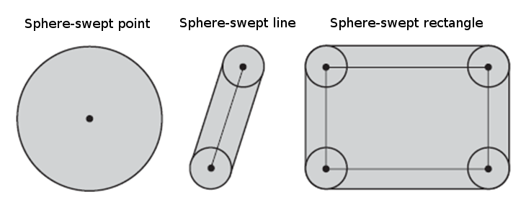
Sphere-Swept Volumes (SSVs)
A sphere-swept volume is the total volume covered when a sphere is swept along some defined line segment. A sphere-swept volume can be represented as the Minkowski sum of a sphere and some other geometric primitive.
Testing for intersection between two SSVs involves determining the minimum (squared) distance between the two inner primitives and comparing it against the (squared) sum of the combined SSV radii.
To provide fast intersection testing, the inner primitives are typically simple, e.g. sphere-swept points (spheres), sphere-swept line (capsules), or sphere-swept rectangles (lozenges)

Slide 13
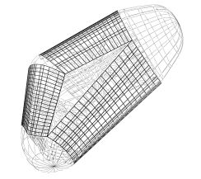
Sphere-Swept Volumes (SSVs)
Capsules and lozenges can be defined as follows:
struct Capsule {
Vector3 StartPoint
Vector3 EndPoint
float Radius
}
Where region R = { x |
(x - [StartPoint +
(EndPoint-StartPoint)*t])^2
<= Radius }, 0 <= t <= 1
struct Lozenge{
Vector3 Centre
Vector3[2] Axis
float Radius
}
Where region R = { x |
(x - [Centre + Axis[0]*s +
Axis[1]*t])^2 <= Radius },
0 <= s,t <= 1
Sphere-swept volume intersection testing simplifies to determining the (squared) distance between the inner primitives (any type of primitive may be used) and comparing this to the (squared) sum of the radii.

Slide 14
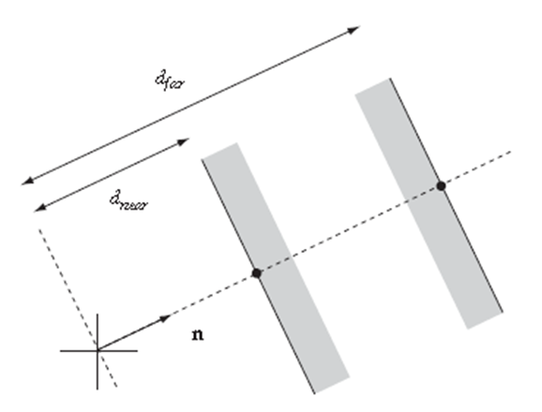
Discrete-Oriented Polytopes (k-DOPs)
A k-DOP is defined as the tightest fixed set of slabs whose normals are defined as a fixed set of axes shared among all k-DOP bounding volumes.
Aside: Kay–Kajiya slab-based volumes. A
slab is the infinite region of space between
two parallel planes. It can be described using
a normal plane vector and the two scalar
distances of each plane from the origin.
To form a closed 3D volume, at least three
slabs are required (e.g. OBB, etc.). Increasing
the number of slabs enables more complex
volumes to be tightly modelled.

Slide 15
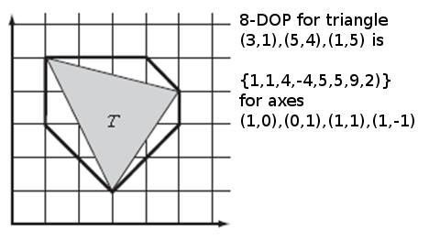
Discrete-Oriented Polytopes (k-DOPs)
In a k-DOP normal components are typically limited to the {-1,0,1} set and not normalised. This entails that k-DOP’s can be quickly dynamically realigned when the bounded object rotates. By sharing normal components only the min and max interval for each axis need be stored.
For example an 8-DOP typically has face normals aligned along (±1,±1,±1), whilst a 12-DOP typically has face normals aligned along (±1,±1,0), (±1,0,±1), (0,±1,±1).
A 6-DOP commonly refers to polytopes with faces aligned along the (±1,0,0) (0,±1,0) (0,0,±1) directions, i.e. it is effectively an AABB and can be stored as:
struct 6-DOP {
float min[3]
float max[3]
}

Slide 16
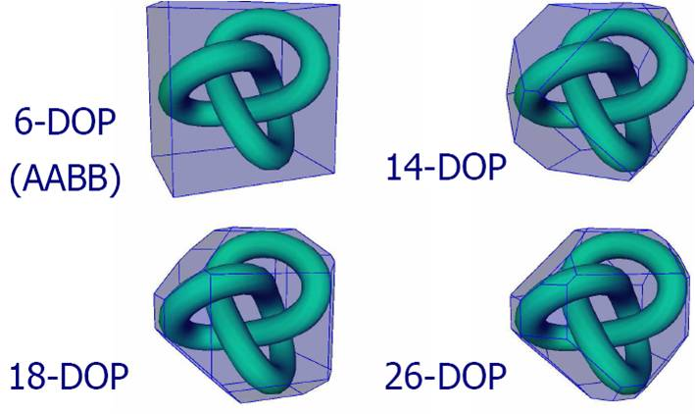
Discrete-Oriented Polytopes (k-DOPs)
In comparison to OBB, intersection tests for k-DOPs are considerably faster (even for large-numbered k values).
Approximately the same amount of storage is needed to store a 14-DOP as an OBB (although the 14-DOP will likely have a tighter fit than the OBB).
The disadvantage of a k-DOP is the cost of updating the k-DOP following a rotation (a k-DOP bounding sphere can be used to provide a quick test to determine if the k-DOP needs to be tumbled). As such, k-DOPs are better used within scenes involving many static objects and a limited number of moving objects.

Slide 17
Discrete-Oriented Polytopes (k-DOPs)
k-DOP intersection test
k-DOP to k-DOP intersection is similar to that of testing two AABB (i.e. all axes are common between k-DOPs). In particular, each slab interval need only be tested for overlap. Only if all interval pairs are overlapping are the k-DOPs intersecting.
bool Overlap( KDOP one, KDOP two )
{
for (int i = 0; i < k / 2; i++)
if (one.min[i] > two.max[i]
|| one.max[i] < two.min[i])
return false;
return true;
}

Slide 18

Directed Reading
Directed
reading
Directed reading on bounding volumes

Slide 19

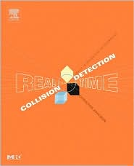
Directed reading
Directed
reading
Read Chapter 4 (pp75-123) of Real Time Collision Detection
Related papers can be found from:
http://realtimecollisiondetection.net/books/rtcd/references/

Slide 20


Summary
Today we explored:
Introduction to bounding volumes.
Explored basic bounds including AABB, OBB, sphere-swept volumes, k-DOPs
To do:
Read the directed material
After reading the directed material, have a ponder if this is the type of material you would like to explore within a project.

